Slide 1
Dying 2 Talk Session 1
Co-producing with young people
Dr Jane Booth
University of Wolverhampton

Slide 2

Why Dying 2 Talk?
Conversations with Bradford Bereavement Support and Child Bereavement UK
Continuing Bonds (University of Bradford)

Slide 3
Why Dying 2 Talk?
Death is a universal event experienced by all living beings.
78% of young people aged 11–16 had experienced the death of either a close relative or a friend (Harrison and Harrington, 2001)
The detrimental effects of child bereavement persist into adulthood and include depression, smoking, risk-taking behaviour, unemployment, poor educational attainment and criminal activity (Aynsley-Green, 2017)

Slide 4
Why Dying 2 Talk?
The professionalisation of death, in which we devolve responsibility to health and social care professionals, diminishes the ‘ordinariness of death’ (Kellehear, 2012: ix), taking care out of the community, and diminishing our capacity, as individuals, family members and friends, to deal with death and dying (Booth et al 2020).
General reluctance to discuss death in broader society, making talking about grief a specialist area rather than an everyday occurrence
(Kellehear, 2012).

Slide 5
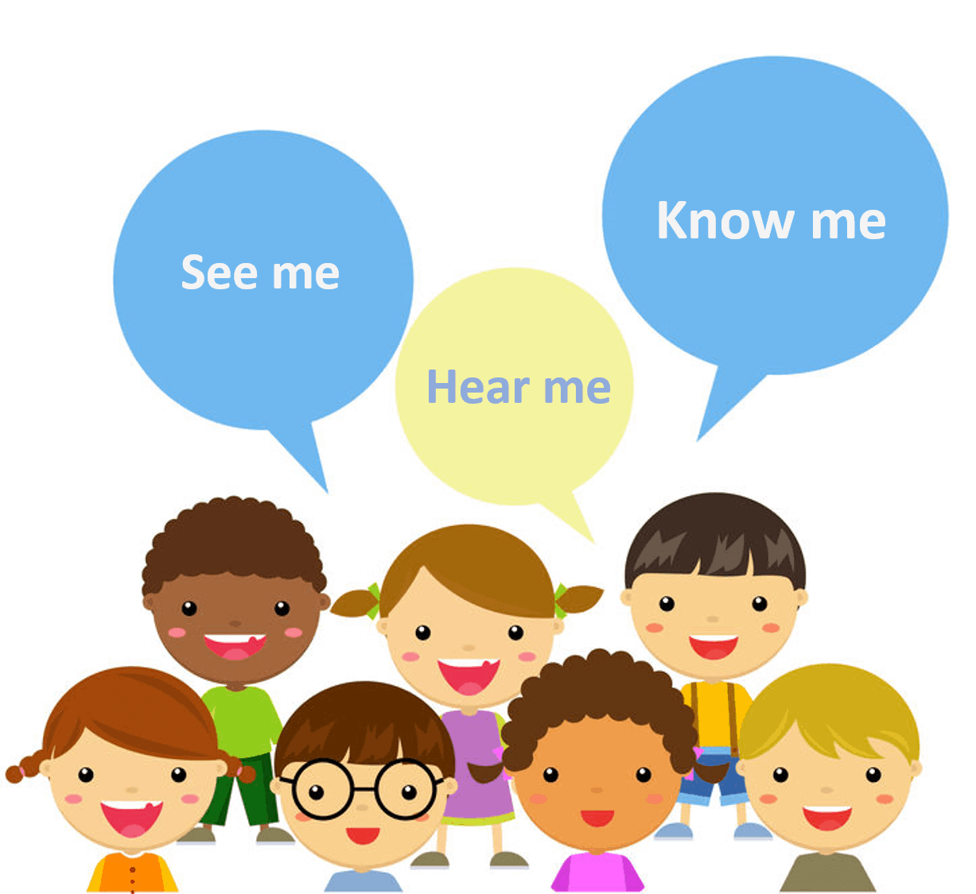
Why co-produce?
Bereavement and young people – often feel a sense of powerlessness (Aynsley-Green, 2017).
Article 12, UN Convention on Rights of the Child: ‘Parties shall assure to the child who is capable of forming his or her own views the right to express those views freely in all matters affecting the child.’

Slide 6
Coproduction
Transformation of power between researchers and those being researched.
Implies ‘mutual respect, no hierarchy of knowledge forms, fluid and permeable disciplinary and professional boundaries, … [and] test(ing) knowledge in the context where the application is required and where implementation will take place’ (Campbell and Vanderhoven et al, 2016: 12).

Slide 7

Our approach…
A particiatory approach as promoted by Strokosch (2013), offered us a model to empower the young people, drawing on their expertise as residents in the local community, as students in the local schools… and as individuals living with loss and bereavement.
The mechanisms employed centred around reframing the relationship between the professionals – the adults – and the young people

Slide 8
What is expertise
Kotzee recognises a range of expertise: ‘rather than view expertise as one phenomenon, it may be fruitful to investigate different expertises in the light of differences between them rather than to force them all into the same mould’ (2012:174).
Recognising, and valuing, the ‘differentiatedness of expertise’ rather than privileging one understanding over another (Kotzee, 2012:175).

Slide 9
Recruitment
Invitation out to local schools, through our networks
Application form – written or video
14-19 years
Employed as Ambassadors (above minimum wage)

Slide 10
Think Ins
Open and safe spaces for all participants to talk and share their opinions, with no formal roles, such as a chair.
Participants frequently worked in smaller sub-groups to develop different aspects of the project – young people choosing which group they wanted to join – served to enhance the ability of some of the young people who were less confident in the larger group to contribute.
The intention was to avoid what Jupp Kina (2012: 215) calls ‘the disjuncture in the dialogical relationship between what we feel, think and do’.

Slide 11
Think Ins
The knowledge and experiences of all participants in the workshops are ‘assigned equal value, irrespective of age or status’ (Dunn et al, 2018) in order to:
establish inclusive ground rules (YP working group)
build bonds
share and respect our different ‘expertises’ ( Kotzee, 2014)

Slide 12
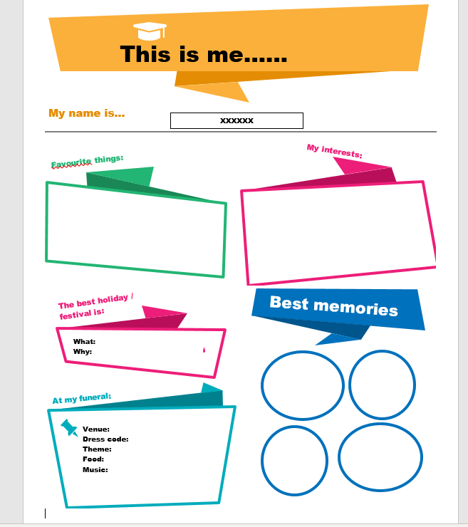
This is Me

Slide 13
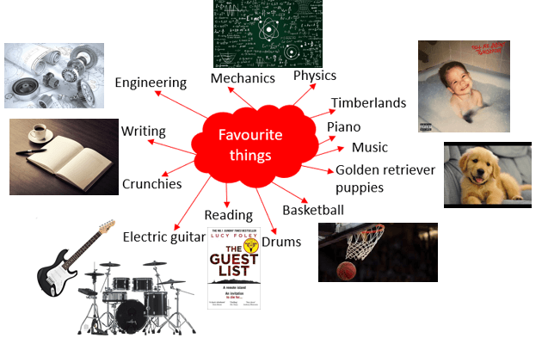






This is XXXX ☺
At my funeral:
Venue - somewhere nice, white walls, glass doors, basically similar to funerals in The Vampire Diaries (and with a chandelier).
Dress Code – Black, dresses and suits similar to the mid or late 1900s.
Theme – Favourite colour, so black, though I would not mind a black and white theme
Music – violins, piano
The best holiday is Christmas because I get to spend time with family who live far away from me and there’s lots of food!
Best Memories
Going to London when I was 10 to visit my aunty – It’s nice when I see my aunty because she buys me lots of things.
My 15th Birthday – we had a barbecue and it was just a lovely day
Every time I see my cousin sister – she’s like my best friend but she lives quite far from me so I don’t get to see her very often. But we’re inseparable together.

Slide 14
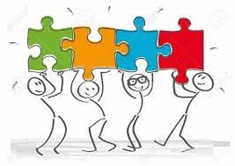
What we learned about co-producing with young people
Excluded young people are experts by their experience and bring essential and unique knowledge, resources and assets which can be drawn upon to create change for individuals and communities (Foot & Hopkins, 2010)

Slide 15
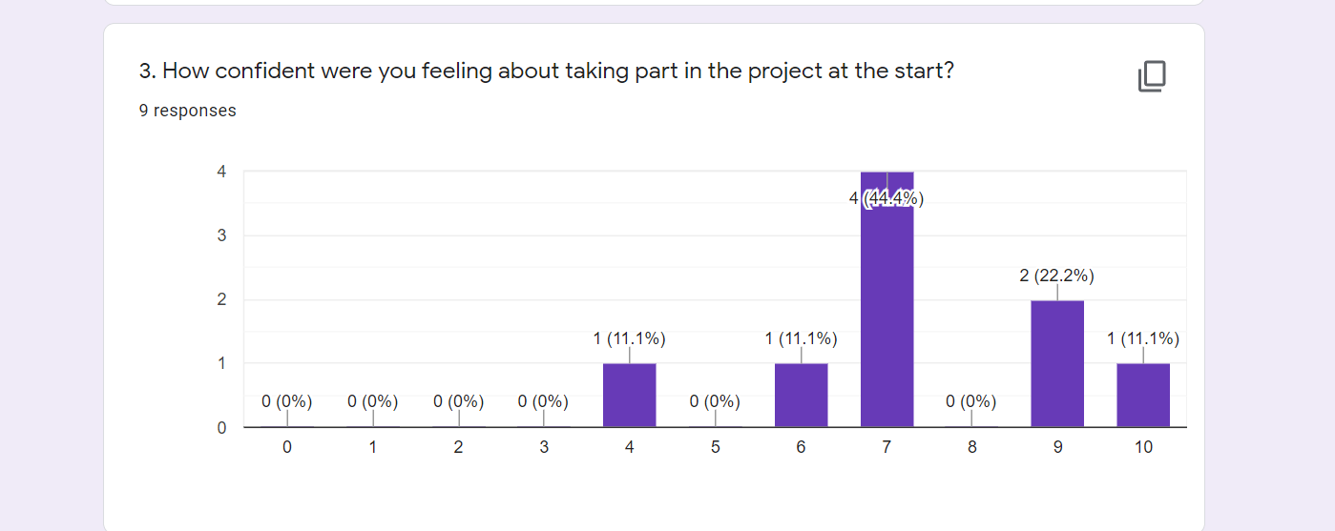

Slide 16
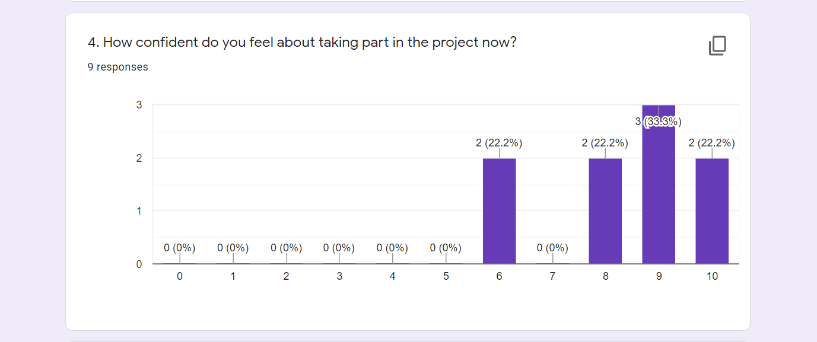

Slide 17
Comments from first evaluation
Confidence
Skills
Much more as I feel I've learnt a lot
I was nervous before it started but I have got to know the ambassadors and found it easy to communicate respectively with everyone.
just feel more confident
Creative thinking, could think of good ideas
i have good communication skills which helped to generate ideas with the group
I believe I have brought my attention for detail skills, used when creating resources

Slide 18
What we learned about co-producing with young people
Power imbalance – have to be constantly vigilant
Confidence – adults and YP!
Need to enable and not pass over responsibility too quickly
Recognising disengagement as a failure of the project and not as a failure of the individual

Slide 19
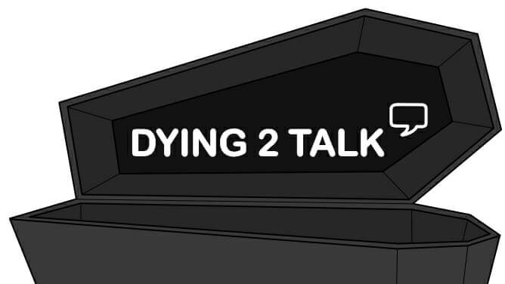
Results

Slide 20
Contact details
Dr Jane Booth (Senior Lecturer in Sociology and Social Policy)
J.booth3@wlv.ac.uk

Slide 21
sources
Aynsley-Green, A. (2017) Think adult—think child! Why should staff caring for dying adults ask what the death means for children in the family?, British Medical Bulletin, 123(1): 5–17, DOI: doi: 10.1093/bmb/ldx026
Booth, J. (2019) ‘Empowering Disadvantaged Communities in UK: Missing the Potential of Co-production’, Social Change, 49(2): 276-292.
Booth, J., Croucher, K. & Bryant, E. (2021) ‘Dying to talk? Co-producing resources with young people to get them talking about bereavement, death and dying’, Voluntary Sector Review, 12 (3) pp. 333-357.
Campbell and Vanderhoven et al (2016) Knowledge that matters: Realising the potential of co-production’ (N8/ESRC Research Programme Report) Manchester: N8 Research partnership
Dunn, V., O’Keeffe, S., Stapley, E. et al. (2018) ‘Facing Shadows: working with young people to coproduce a short film about depression’ Research Involvement and Engagement, 4 (46) https://doi.org/10.1186/s40900-018-0126-y
Foot, J., & Hopkins, T. ( 2010 ). A Glass Half Full: How An Asset Approach Can Improve Community Health and Well‐Being. UK : IDEA Healthy Communities.
Harrison, L. and Harrington, R. (2001) Adolescents’ bereavement experiences: prevalence, association with depressive symptoms, and use of services, Journal of Adolescence, 24(2): 159–69
Kellehear, A. (2012) Compassionate Cities: Public Health and End-of-Life Care, London: Routledge
Kirby, P.A. (2004) Guide to actively involving young people in research: for researchers, research commissioners, and managers, Eastleigh: INVOLVE
Kotzee, B. (2012) Expertise, fluency and social realism about professional knowledge, Journal of Education and Work, 27(2): 161–78.

